Slide 1


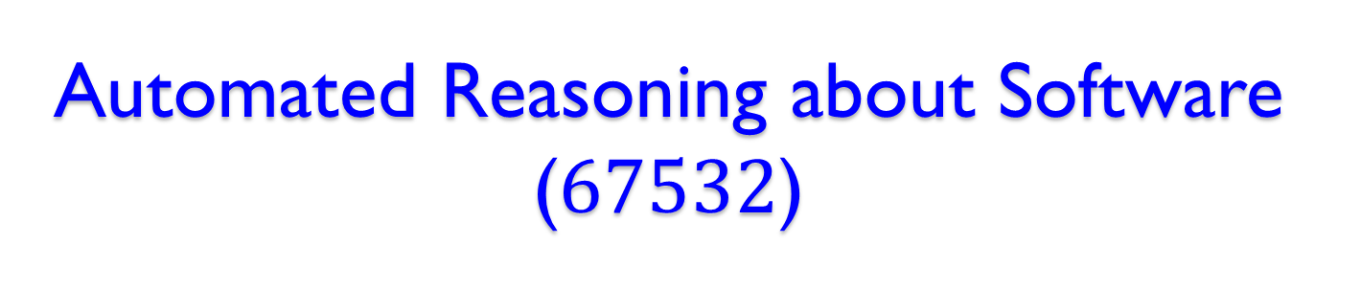
Automated Reasoning about Software ($67532$)
Guy Katz
Lecture $1$: Introduction October $28$^{th}, $2019$

Slide 2
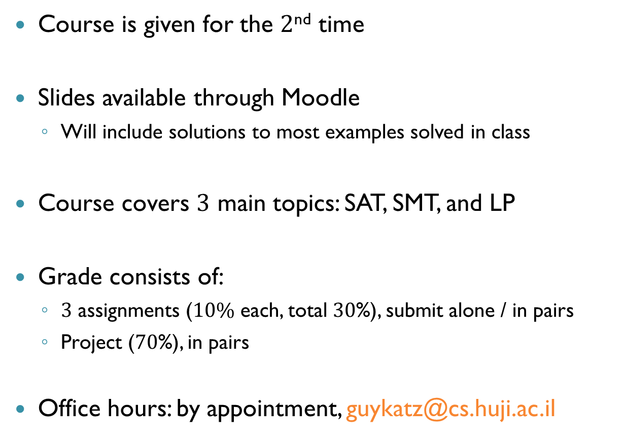
Technical Details
Course is given for the $2$^{nd} time
Slides available through Moodle
Will include solutions to most examples solved in class
Course covers $3$ main topics: SAT, SMT, and LP
Grade consists of:
$3$ assignments ($10\%$ each, total $30$%), submit alone / in pairs
Project ($70$%), in pairs
Office hours: by appointment, guykatz@cs.huji.ac.il

Slide 3

The Software Crisis
“… as long as there were no machines, programming was no problem at all; when we had a few weak computers, programming became a mild problem, and now we have gigantic computers, programming has become an equally gigantic problem.”
— E. Dijkstra, 1972

Slide 4
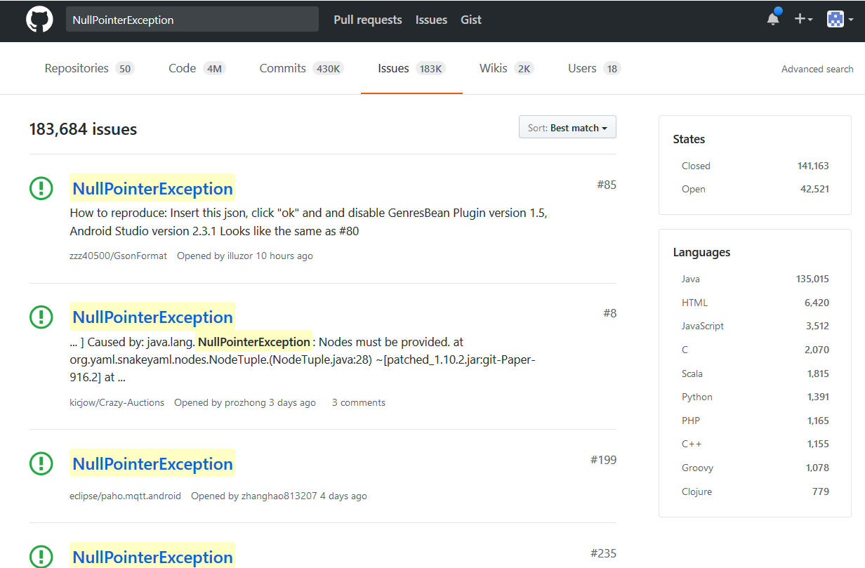
Errors are Abundant

Slide 5
The Software Crisis (cnt’d)
Software is everywhere
Important that software be bug-free
Writing reliable software is hard
How can we improve software reliability using automated tools?

Slide 6
But first, a few motivating examples…

Slide 7
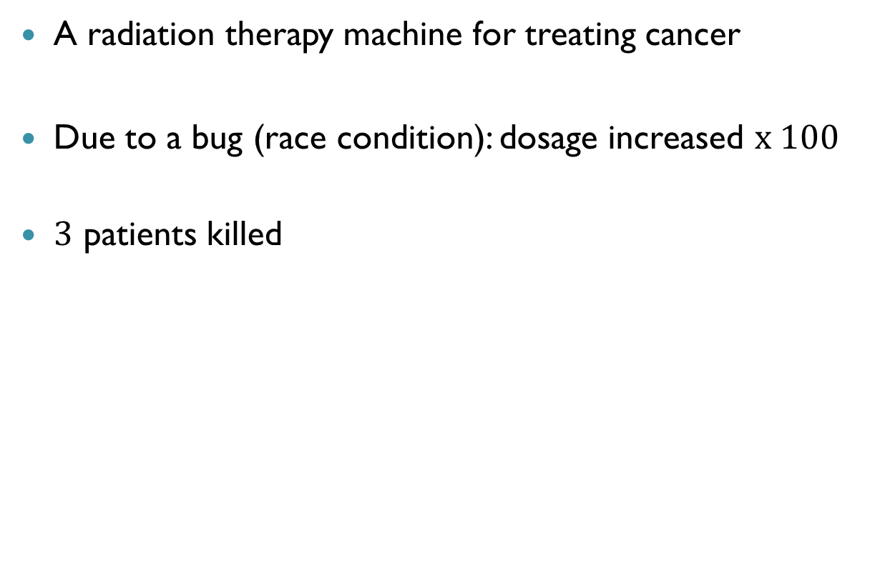

Therac-25 ($1985$)
A radiation therapy machine for treating cancer
Due to a bug (race condition): dosage increased $x 100$
$3$ patients killed

Slide 8
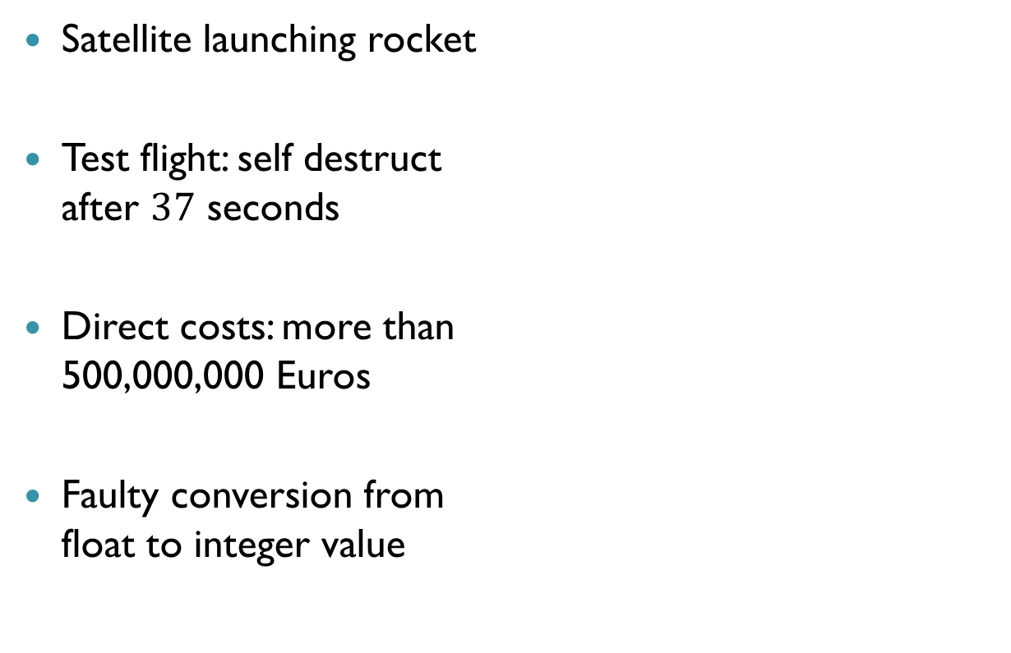

Ariane 5 ($1996$)
Satellite launching rocket
Test flight: self destruct after $37$ seconds
Direct costs: more than 500,000,000 Euros
Faulty conversion from float to integer value

Slide 9


Heartbleed ($2014$)
Security bug in OpenSSL
A buffer over-read error
Damage estimates:
5% of top level internet domains

Slide 10
These bugs were caused by human engineers. Use machine learning?

Slide 11
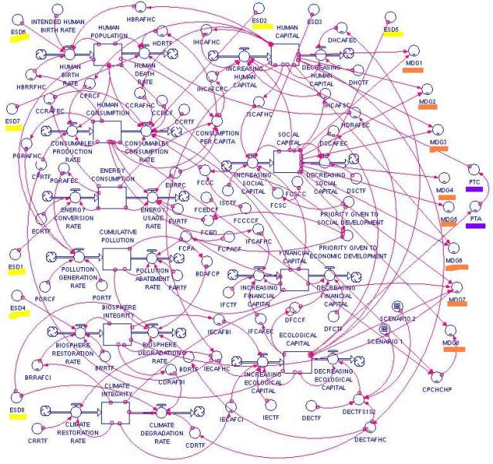


Programming by Machine Learning
Requirements
Training Algorithm
Artifact
Input/Output Pairs

Slide 12


Autonomous Vehicles ($2017$)
Tesla model-s autopilot slams into a wall

Slide 13
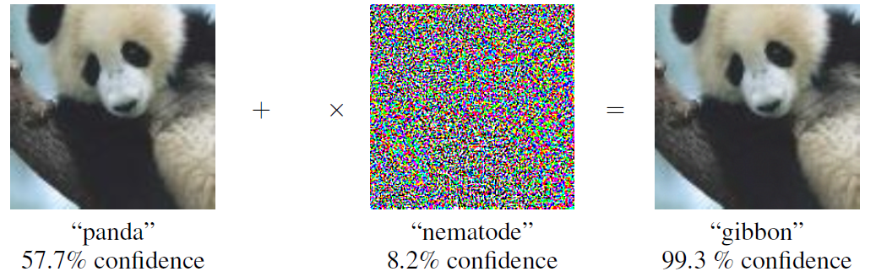

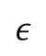
Adversarial Inputs ($2014−?$)
Slight input perturbations cause misclassification
State-of-the-art networks are vulnerable
$$ε$$

Slide 14
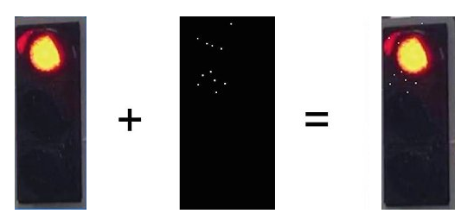

Adversarial Inputs (cnt’d)
Attacks exist in the real world
Traffic Light
$11$ White Pixels
Oven

Slide 15
So, what can be done?

Slide 16
Testing and Simulation
The most common approaches for quality assurance
Complex systems, corner cases hard to catch
Bugs discovered late
Already consumes 30%-50% of project’s resources

Slide 17
Formal Methods
A mathematical approach for reasoning about software
Reasoning: characterize, develop, and verify correctness
Formal methods provide very strong guarantees!
But, using them is difficult, and requires expertise
Mostly used for safety-critical systems
Although this is changing

Slide 18
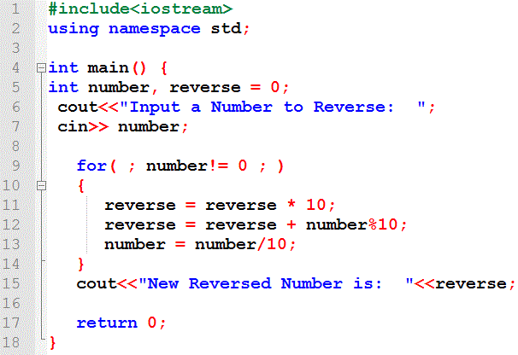
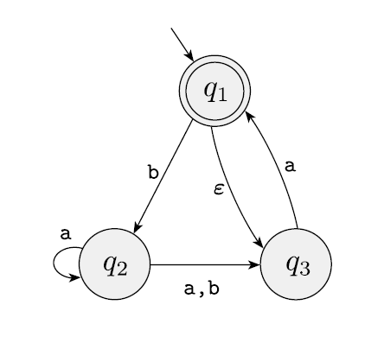



Formal Verification
Formally prove that a program is correct
Verification
+ Counter-Example

Slide 19
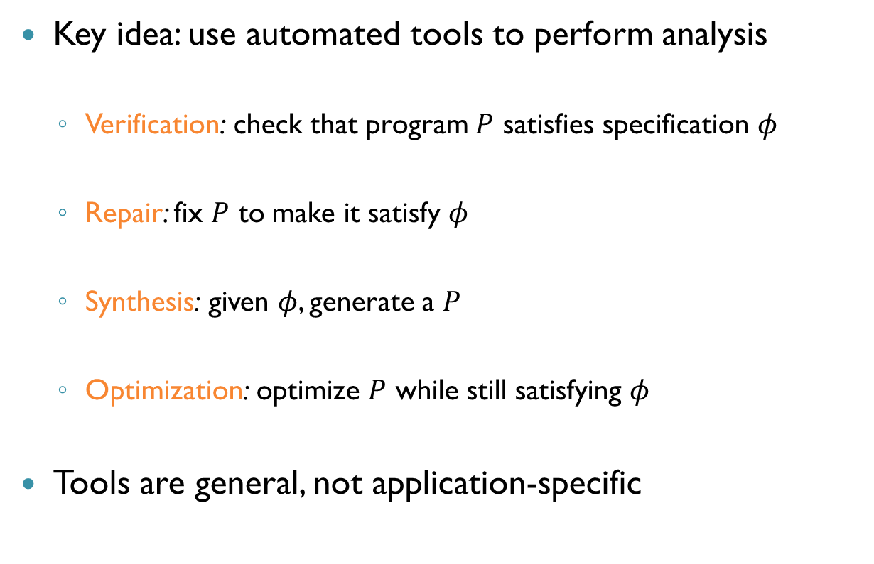
Automatic Analysis
Key idea: use automated tools to perform analysis
Verification: check that program $P$ satisfies specification $φ$
Repair: fix $P$ to make it satisfy $φ$
Synthesis: given $φ$, generate a $P$
Optimization: optimize $P$ while still satisfying $φ$
Tools are general, not application-specific

Slide 20
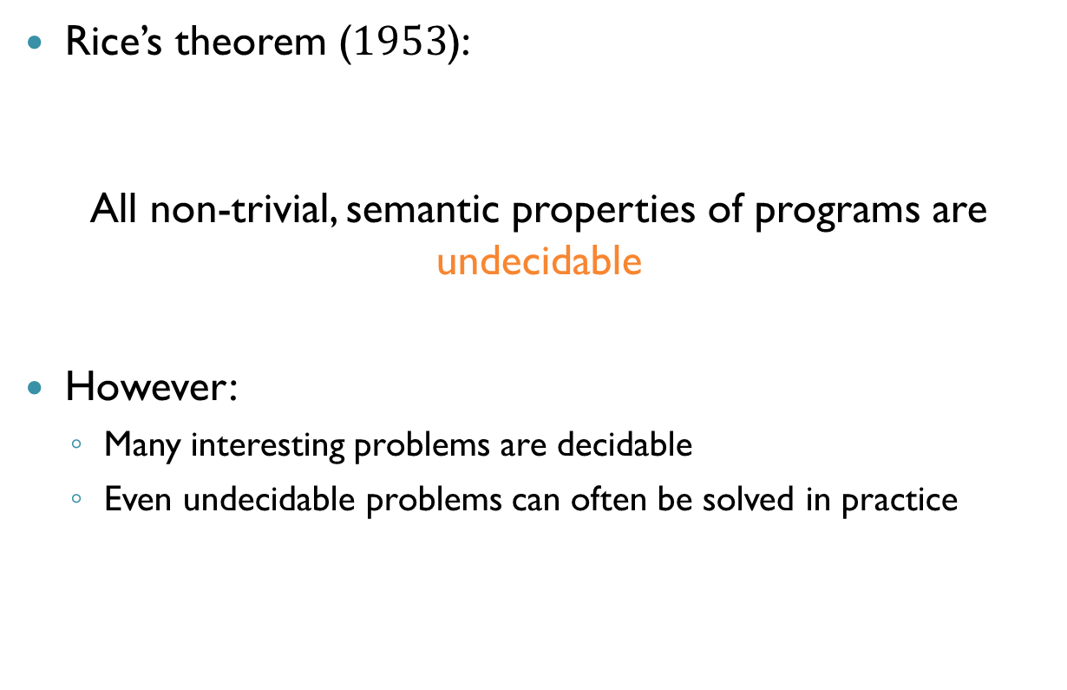
Limitations
Rice’s theorem ($1953$):
All non-trivial, semantic properties of programs are undecidable
However:
Many interesting problems are decidable
Even undecidable problems can often be solved in practice

Slide 21
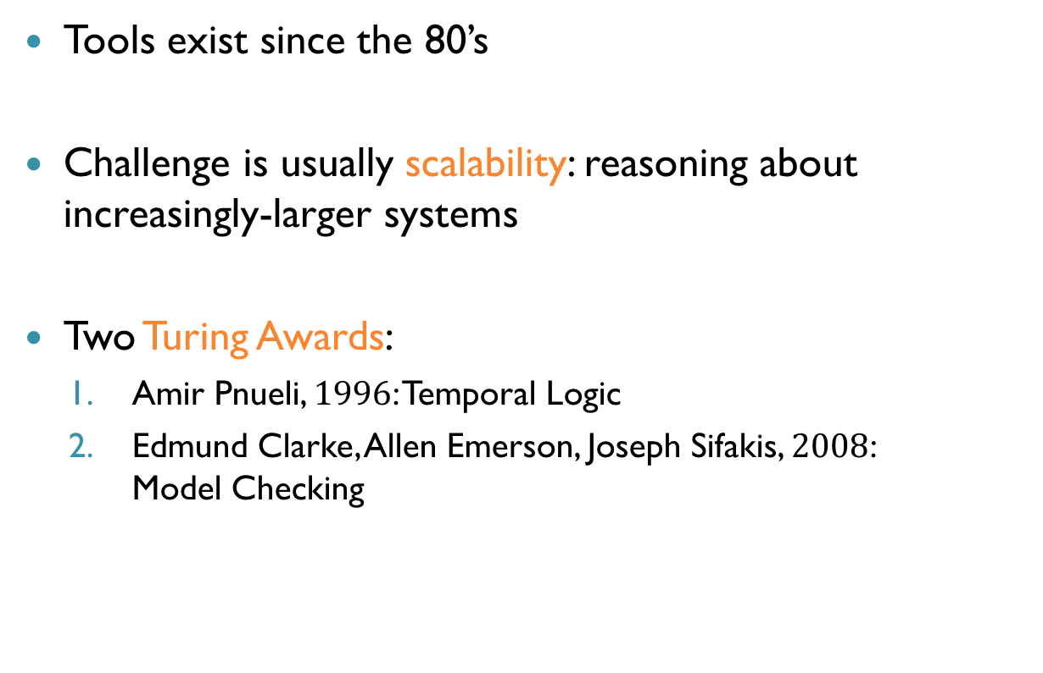
Automated Reasoning in Practice
Tools exist since the 80’s
Challenge is usually scalability: reasoning about increasingly-larger systems
Two Turing Awards:
Amir Pnueli, $1996$: Temporal Logic
Edmund Clarke, Allen Emerson, Joseph Sifakis, $2008$: Model Checking

Slide 22
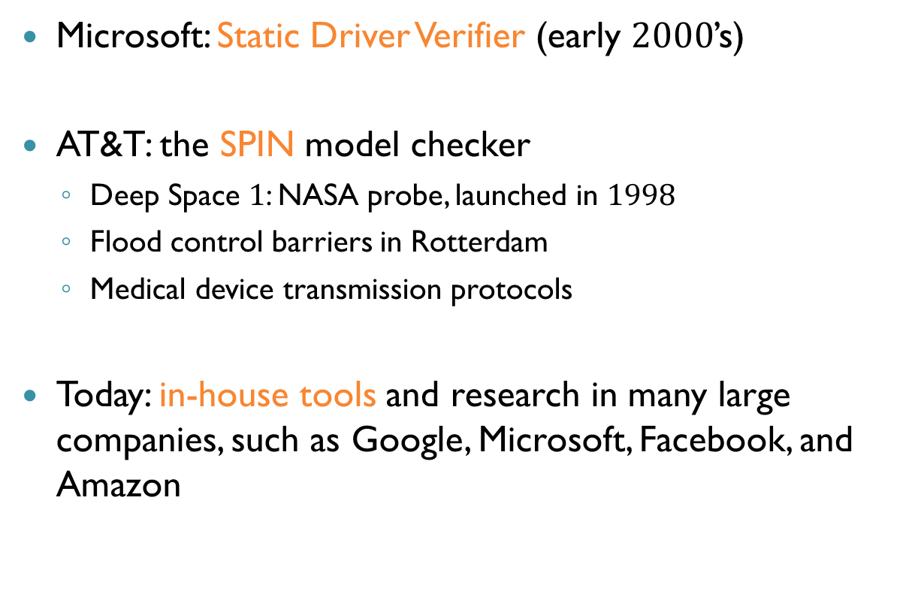
Some Success Stories
Microsoft: Static Driver Verifier (early $2000$’s)
AT&T: the SPIN model checker
Deep Space $1$: NASA probe, launched in $1998$
Flood control barriers in Rotterdam
Medical device transmission protocols
Today: in-house tools and research in many large companies, such as Google, Microsoft, Facebook, and Amazon

Slide 23
Back to this course

Slide 24
Automated Solvers
Creating automated analysis tools is difficult
Don’t want to create a new tool every time
Solution: general purposes solvers
Typical input: variables and constraints
A satisfiability problem
Solver needs to either:
Find an assignment that satisfies the constraints (SAT)
Prove that no assignment satisfies the constraints (UNSAT)

Slide 25
Automated Solvers (cnt’d)
Solver are highly optimized
If you use them, you benefit when they are improved
Can translate many interesting problems into satisfiability problems

Slide 26
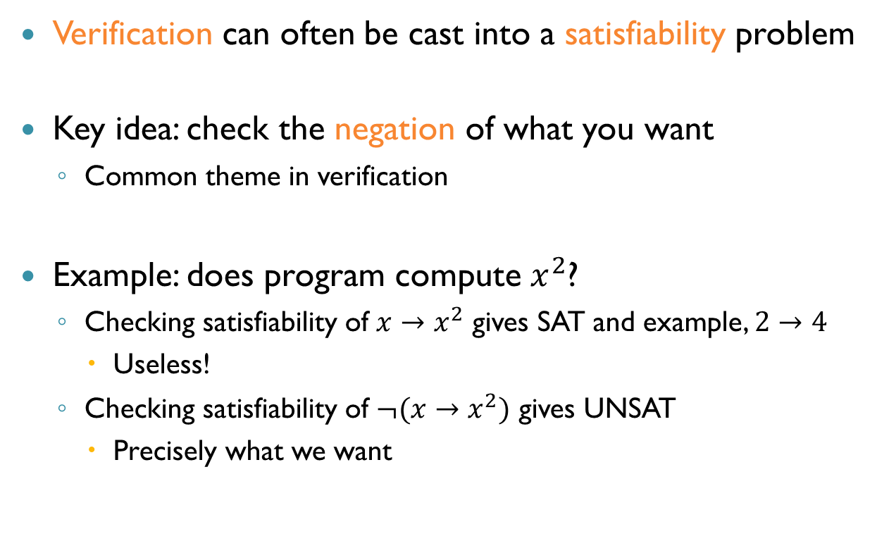
Verification as Satisfiability
Verification can often be cast into a satisfiability problem
Key idea: check the negation of what you want
Common theme in verification
Example: does program compute $x^{2}$?
Checking satisfiability of $x→x^{2}$ gives SAT and example, $2→4$
Useless!
Checking satisfiability of $¬(x→x^{2})$ gives UNSAT
Precisely what we want

Slide 27
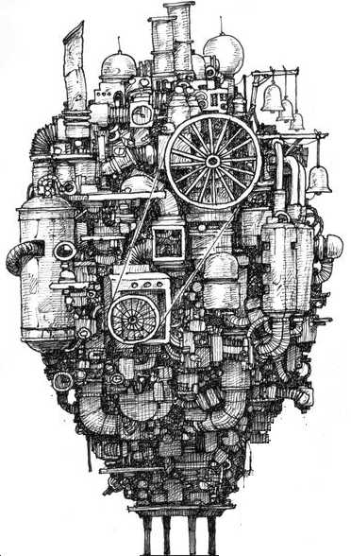
Who Watches the Watchmen?
What happens when your analysis tool has a bug?
When many people use a solver, reliability increases
SAT answers: can just assign and check
UNSAT answers: can produce a proof

Slide 28
Kinds of Solvers
We will focus on three kinds of solvers:
Boolean Satisfiability (SAT) solvers Inputs are Boolean formulas
Satisfiability Modulo Theories (SMT) solvers Inputs are richer, first-order logic formulas
Linear Programming (LP) solvers Inputs are linear equations and an objective function
For each solver we will study about applications, the underlying theory and efficient implementations

Slide 29
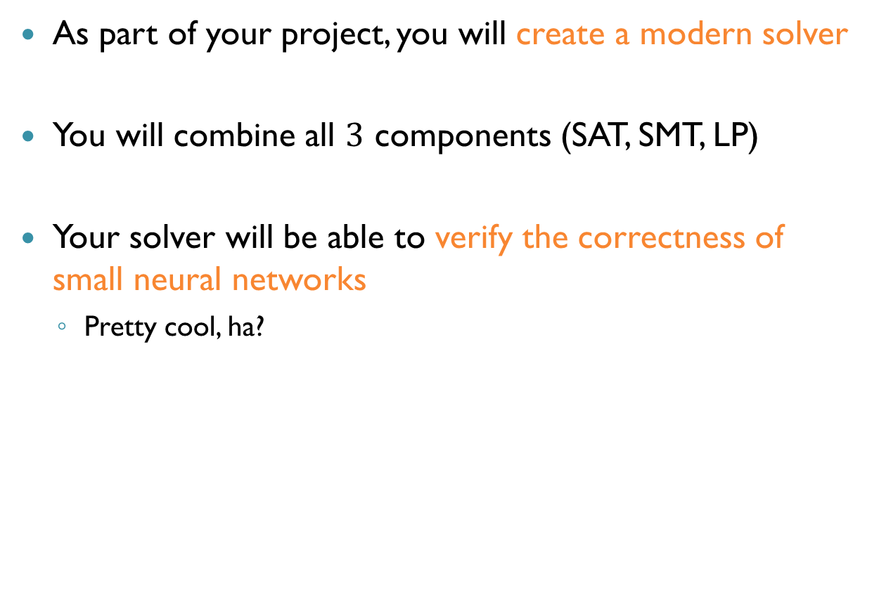
Final Project
As part of your project, you will create a modern solver
You will combine all $3$ components (SAT, SMT, LP)
Your solver will be able to verify the correctness of small neural networks
Pretty cool, ha?

Slide 30
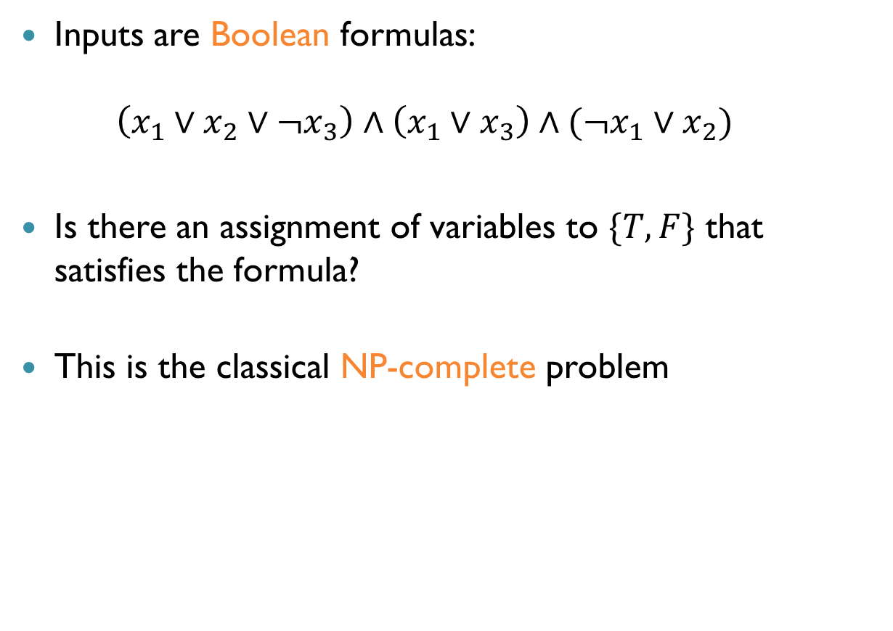
SAT Solvers
Inputs are Boolean formulas: $\left(x_{1}∨x_{2}∨¬x_{3}\right)∧\left(x_{1}∨x_{3}\right)∧(¬x_{1}∨x_{2})$
Is there an assignment of variables to $\{T,F\}$ that satisfies the formula?
This is the classical NP-complete problem

Slide 31
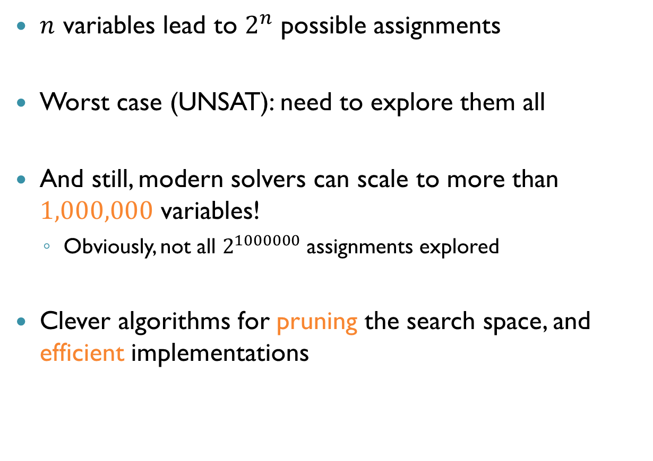
SAT Solvers (cnt’d)
$n$ variables lead to $2^{n}$ possible assignments
Worst case (UNSAT): need to explore them all
And still, modern solvers can scale to more than $1,000,000$ variables!
Obviously, not all $2^{1000000}$ assignments explored
Clever algorithms for pruning the search space, and efficient implementations

Slide 32
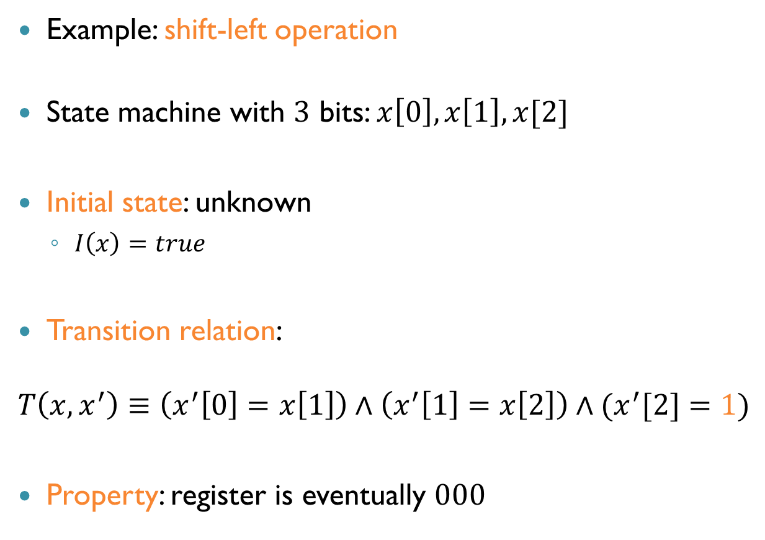
SAT Solvers Applications: Bounded Model Checking
Example: shift-left operation
State machine with $3$ bits: $x\left[0\right], x\left[1\right], x[2]$
Initial state: unknown
$I\left(x\right)=true$
Transition relation:
$$T\left(x,x^{′}\right)≡\left(x^{′}\left[0\right]=x\left[1\right]\right)∧\left(x^{′}\left[1\right]=x\left[2\right]\right)∧(x^{′}[2]=1)$$
Property: register is eventually $000$

Slide 33
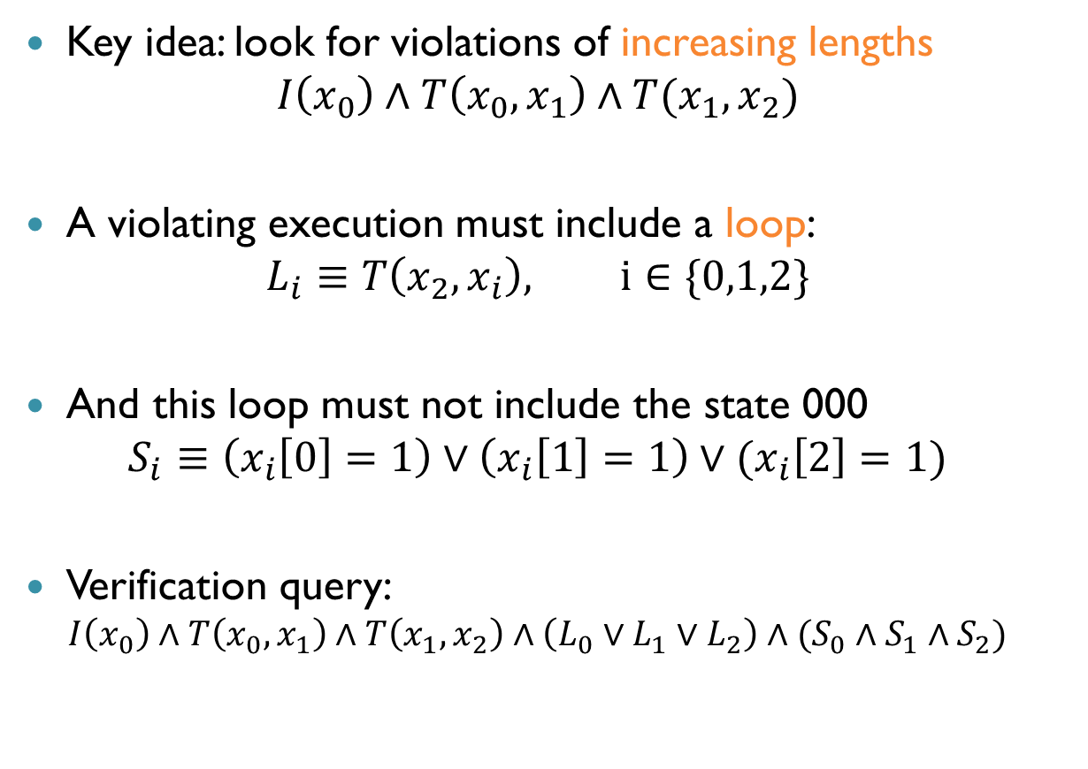
SAT Solvers Applications: Bounded Model Checking (cnt’d)
Key idea: look for violations of increasing lengths
$$I\left(x_{0}\right)∧T\left(x_{0},x_{1}\right)∧T(x_{1},x_{2})$$
A violating execution must include a loop:
$$L_{i}≡T\left(x_{2},x_{i}\right), i∈\{0,1,2\}$$
And this loop must not include the state 000
$$S_{i}≡\left(x_{i}\left[0\right]=1\right)∨\left(x_{i}\left[1\right]=1\right)∨(x_{i}\left[2\right]=1)$$
Verification query:
$$I\left(x_{0}\right)∧T\left(x_{0},x_{1}\right)∧T\left(x_{1},x_{2}\right)∧\left({L_{0}∨L}_{1}∨L_{2}\right)∧(S_{0}∧S_{1}∧S_{2})$$

Slide 34
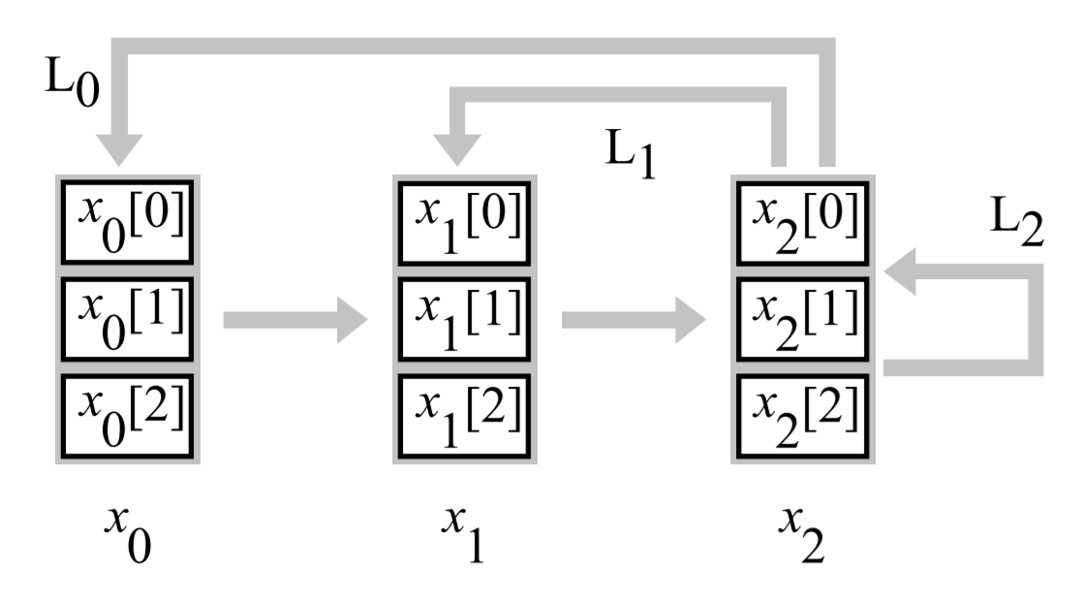
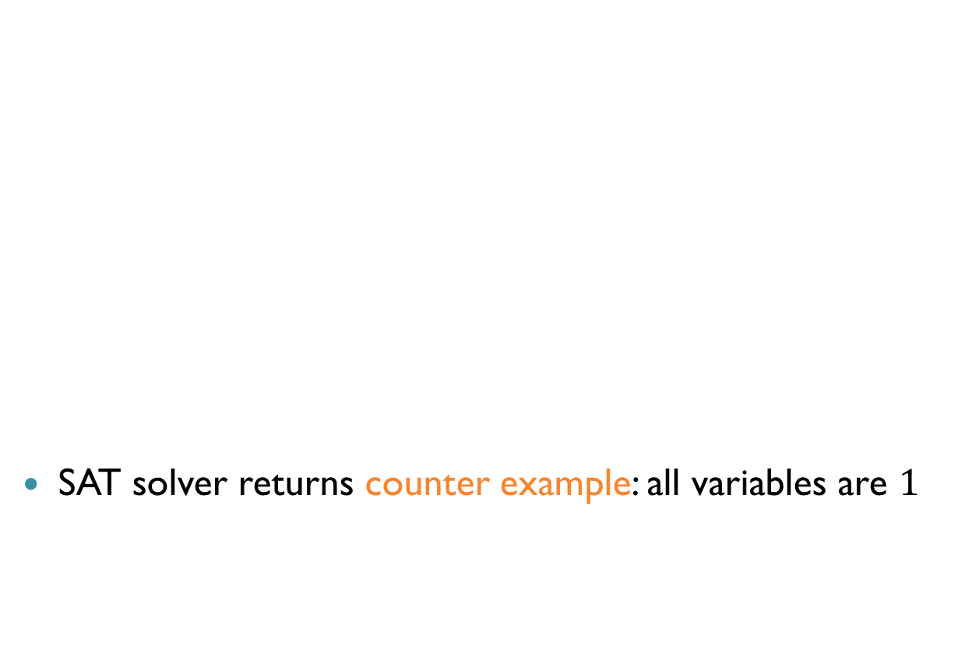
SAT Solvers Applications: Bounded Model Checking (cnt’d)
SAT solver returns counter example: all variables are $1$

Slide 35
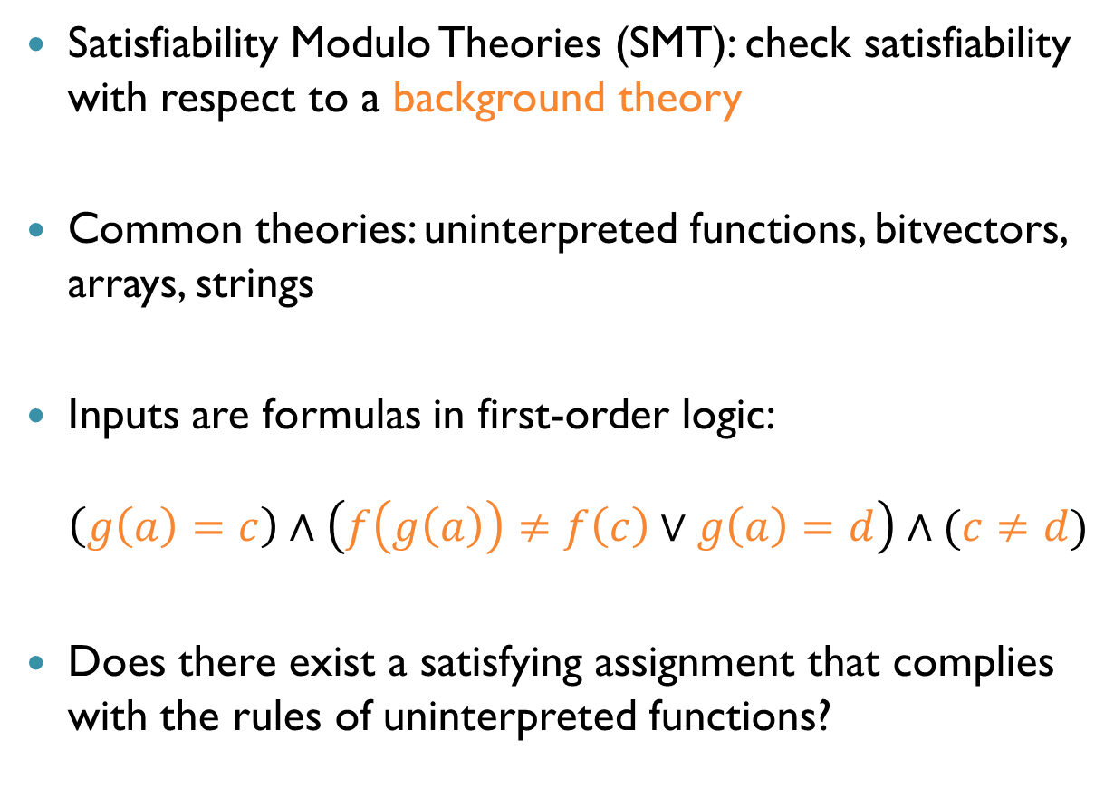
SMT Solvers
Satisfiability Modulo Theories (SMT): check satisfiability with respect to a background theory
Common theories: uninterpreted functions, bitvectors, arrays, strings
Inputs are formulas in first-order logic: $\left(g\left(a\right)=c\right)∧\left(f\left(g\left(a\right)\right)≠f\left(c\right)∨g\left(a\right)=d\right)∧(c≠d)$
Does there exist a satisfying assignment that complies with the rules of uninterpreted functions?

Slide 36
SMT Solvers
In general, the satisfiability problem for first-order logic formulas is undecidable
But, for many interesting fragments, it is decidable
… and even if not, problems can sometimes be solved!
Key SMT idea: separately solve Boolean formula and background theory formulas!

Slide 37
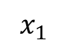
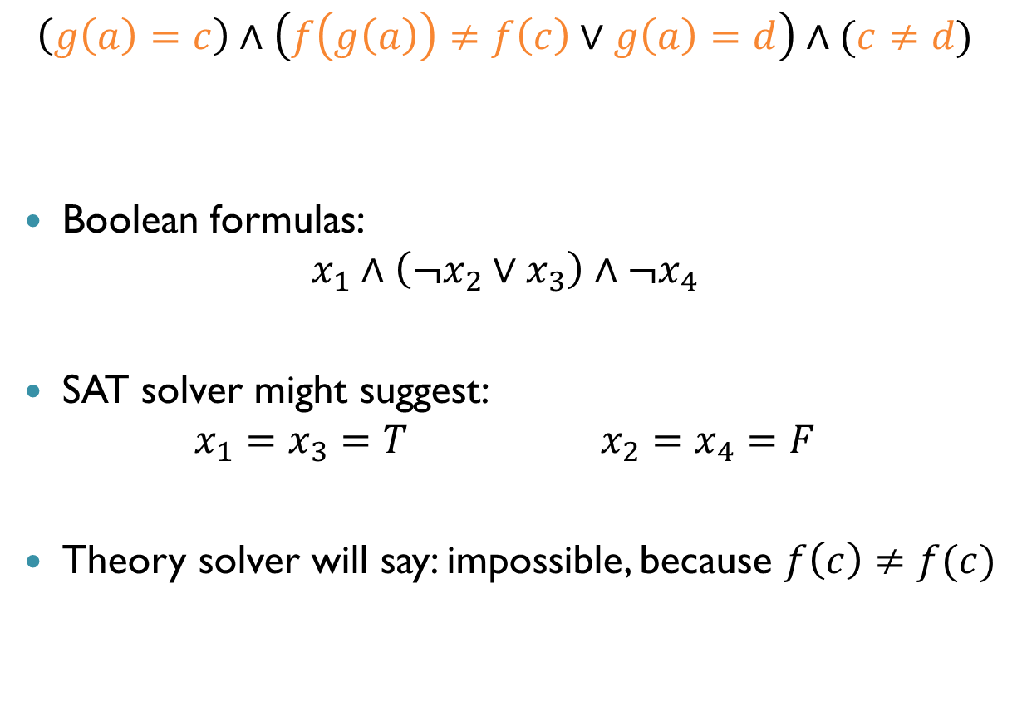
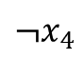
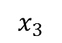
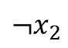
SMT Solvers
$$\left(g\left(a\right)=c\right)∧\left(f\left(g\left(a\right)\right)≠f\left(c\right)∨g\left(a\right)=d\right)∧(c≠d)$$
Boolean formulas: $x_{1}∧\left(¬x_{2}∨x_{3}\right)∧¬x_{4}$
SAT solver might suggest: $x_{1}=x_{3}=T x_{2}=x_{4}=F$
Theory solver will say: impossible, because $f\left(c\right)≠f(c)$
$$x_{1}$$
$$¬x_{2}$$
$$x_{3}$$
$$¬x_{4}$$

Slide 38
The DPLL(T) Architecture
Arithmetic
Uninterpreted Functions
Sets
SAT Solver
Bitvectors
Arrays

Slide 39
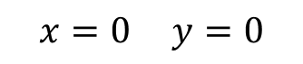
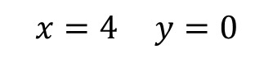
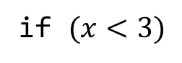
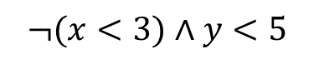
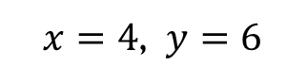
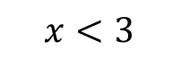

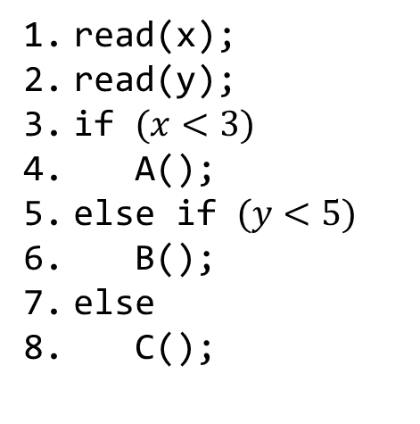
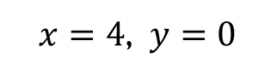
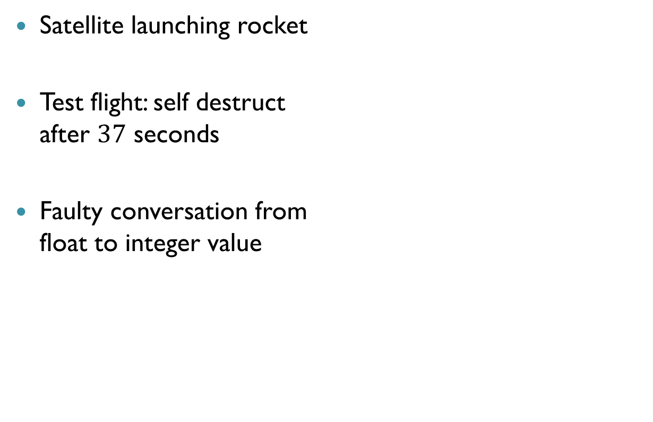

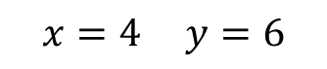
SMT Applications: Symbolic Execution
$$x=0 y=0$$
$$x=4 y=0$$
read(x);
read(y);
if $(x<3)$
A();
else if $(y<5)$
B();
else
C();
$$x=4 y=6$$
if $(x<3)$
false
true
if $(y<5)$
A()
false
true
$$x<3$$
C()
B()
$$¬(x<3)∧y<5$$
SMT
$$¬\left(x<3\right)∧¬ (y<5)$$
$$¬(x<3)$$
$x=4$, $y=0$
$x=4$, $y=6$

Slide 40
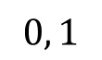
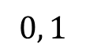
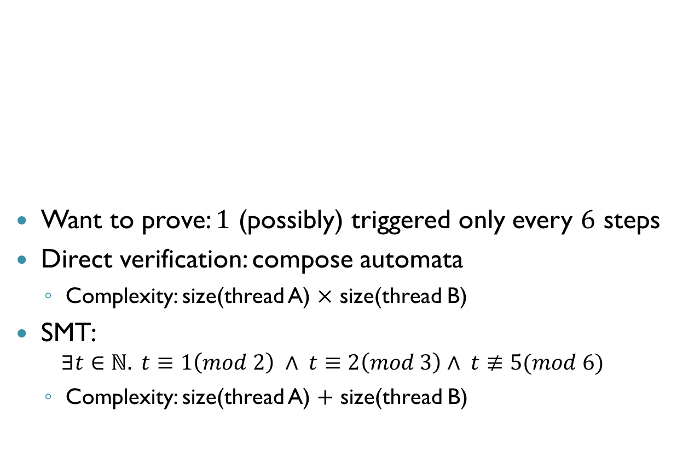
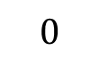
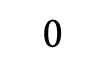
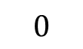
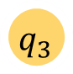
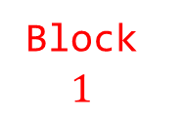
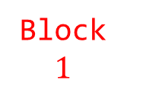
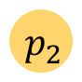






SMT Applications: Compositional Verification
Want to prove: $1$ (possibly) triggered only every $6$ steps
Direct verification: compose automata
Complexity: size(thread A) $×$ size(thread B)
SMT:
$$∃t∈ℕ. t≡1\left(mod 2\right) ∧ t≡2\left(mod 3\right)∧ t≢5(mod 6)$$
Complexity: size(thread A) $+$ size(thread B)
Thread A
$$0, 1$$
Thread B
$$0, 1$$
$$p_{1}$$
$$p_{2}$$
$$p_{2}$$
$$q_{1}$$
$$q_{2}$$
$$q_{3}$$
$$q_{3}$$
$$0$$
$$0$$
$$0$$
Block $1$
Block $1$
Block $1$

Slide 41


Linear Programming (LP) Solvers
Inputs are linear constraints and an objective function
Phase $1$: satisfy the linear constraints
Phase 2: optimize for the cost function
Maximize | $$2x_{1}−x_{2}$$
Subject to | $$x_{1}−x_{2}≤1$$ $$−x_{1}+3x_{2}≤−2$$ $$x_{1}≥0$$ $$x_{2}≥0$$

Slide 42

The Simplex Algorithm
Simplex: an efficient algorithm for solving LP
Key ideas:
Translate all equations into equalities $x_{1}+x_{2}≥3$ becomes $x_{1}+x_{2}+x_{3}=3, x_{3}≤0$
Mark one variable as basic in every equation: $x_{2}=−x_{1}−x_{2}+3$
Iteratively, update assignment of non-basic variables or pivot (swap) one pair of basic and non-basic variables
Guaranteed to converge, although not necessarily in polynomial time

Slide 43


LP Applications: Verifying Neural Networks
+ Noise
Classification: Panda
Classification: Gibbon

Slide 44

Verifying Neural Networks
Does an input property imply an output property?
Input is Panda + noise $⇒$ Output class is Panda?
This problem is NP-complete
Exponential in the size of the network
Verifying a network with $300$ nodes may require $2^{300}$ actions
Can be translated into a series of queries to an LP solver
Plus some modifications for efficiency…

Slide 45







Activation Functions
Steps:
Weighted sum
Activation function
$$2$$
$$1$$
$$0$$
$$3$$
$$f(4)$$
$$2⋅1+0⋅3+(−1)⋅\left(−2\right)=4$$
$$−1$$
$$−2$$

Slide 46













Rectified Linear Units (ReLUs)
ReLU($x$) = $max⁡(0,x)$
$x≥0$: active case, return $x$
$x<0:$ inactive case, return $0$
$$2$$
$$1$$
$$1$$
$$0$$
$$3$$
$$−2$$
$$0$$
$$4$$
$$1⋅1+\left(−2\right)⋅3+0⋅\left(−2\right)=−5$$
$$2⋅1+0⋅3+(−1)⋅\left(−2\right)=4$$
$$−1$$
$$−2$$
$$0$$

Slide 47
Case Splitting
A property: linear constraints on inputs and outputs
Without activation functions, network would be linear
Linear programs are easy to solve
Handling ReLUs: translate into a sequence of linear problems

Slide 48





Case Splitting (cnt’d)
Case splitting approach:
Fix each ReLU to a linear segment (active or inactive)
Solve the resulting linear problem
If property is violated for this configuration, stop
But if property holds, backtrack and try other option
State explosion: $300$ReLUs $→2^{300}$ checks
$$a+b+c=5, b>c$$
$$y=ReLU(x)$$
$$a+b+c=5, b>c$$
$$y=x, x≥0$$
$$a+b+c=5, b>c$$
$$y=0, x≤0$$

Slide 49


Example: ACAS Xu
Airborne Collision-Avoidance System for drones
A new standard being developed by the FAA
Produce advisories:
Strong left (SL)
Weak left (L)
Strong right (SR)
Weak right (R)
Clear of conflict (COC)
FAA considering an implementation that uses $45$ deep neural networks

Slide 50


ACAS Xu: Example $1$
“If the intruder is near and approaching from the left, the network advises strong right”
Distance: $12000≤ρ≤62000$
Angle to intruder: $0.2≤θ≤0.4$
…
Property proved using verification
Notes:
Property 5 in the paper

Slide 51

ACAS Xu: Example 2
“If vertical separation is large and the previous advisory is weak left, the network advises COC or weak left”
Distance: $0≤ρ≤60760$
Time to loss of vertical separation: $τ=100$
…
Counter-example discovered using verification
Notes:
Property 8 in the paper

Slide 52
Neural Network Verification
Neural network verification reduces solving (many) LPs
LPs easy to solve,
But their number can be exponential in size of network
Solving LPs quickly plays a key role
Can be combined with SAT and SMT techniques
Customize simplex to work better on these problems?

